Slide 1
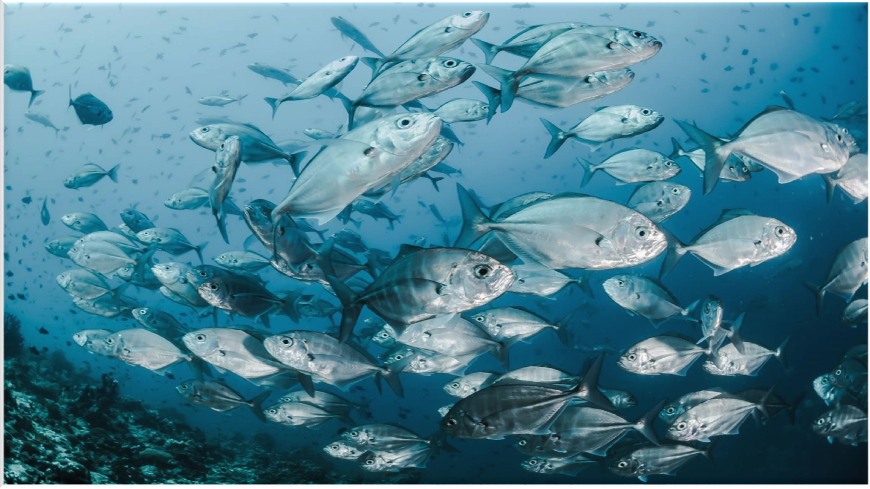
AQUA FISHERIES AQUACULTURE
2024 AQUAFAQ
AQUAFAQ COMPLEX
1

Slide 2
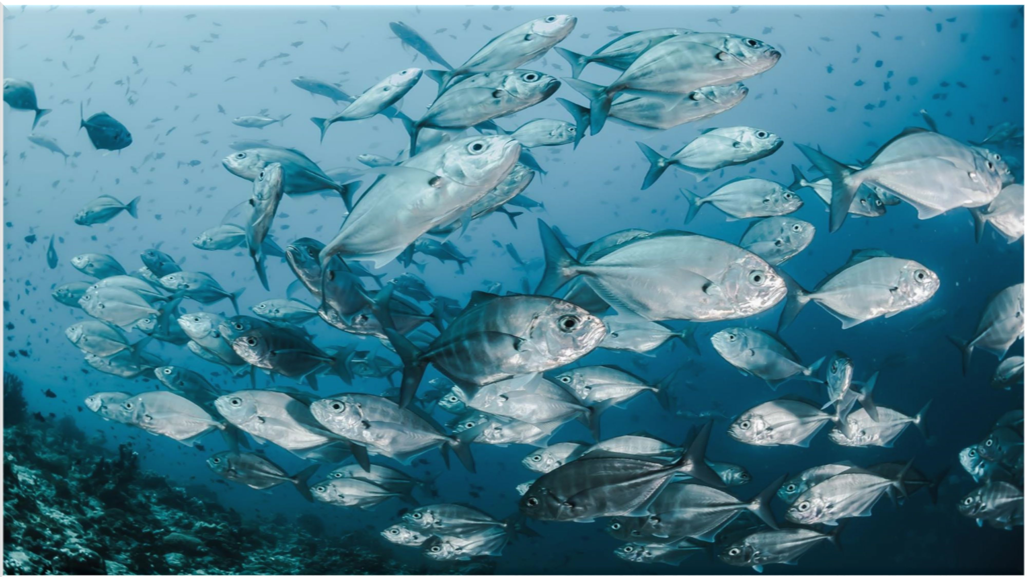
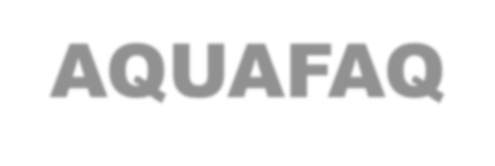
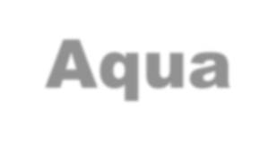
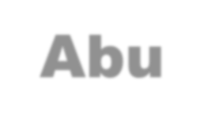
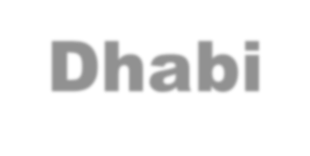
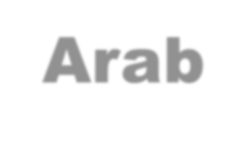
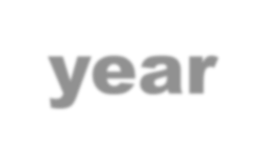
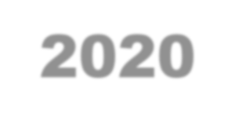
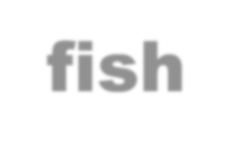
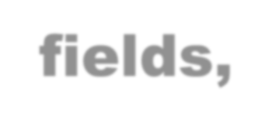
ABOUT US
2024 AQUAFAQ
AQUAFAQ Aqua Fisheries Aquaculture is proud to be the first to be land base and sea base company in the Emirate of Abu Dhabi , United Arab Emirates founded in the year 2020.
We successfully manage to form consortium of the top global players in fish farming fields, our strategic partners cover the environmental the technology training and feeding

Slide 3
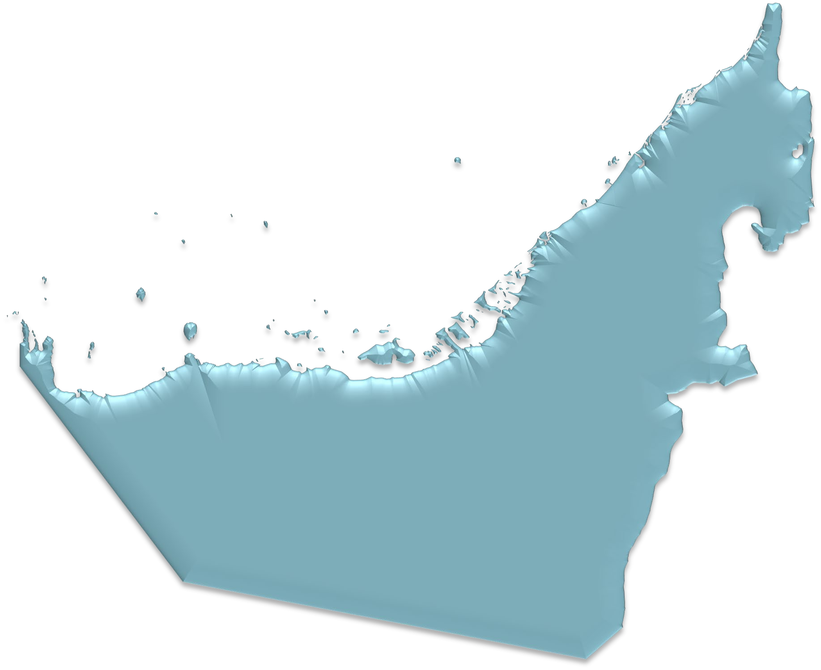
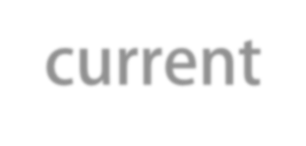
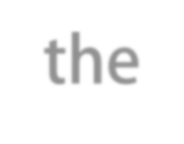
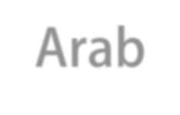
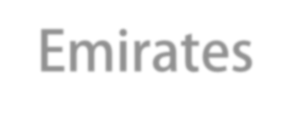
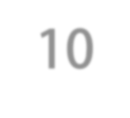
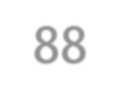
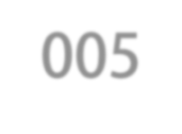
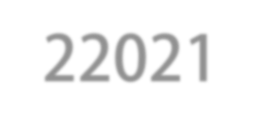
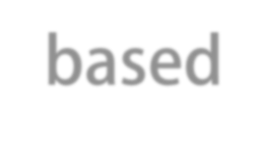
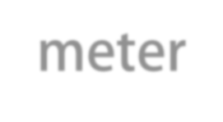
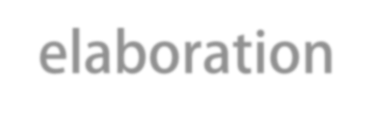
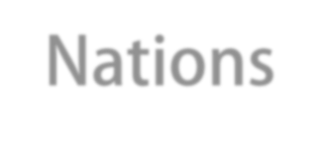
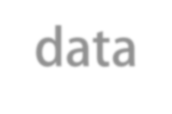
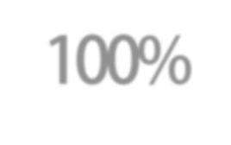
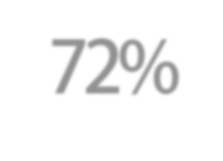
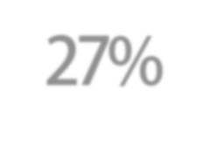
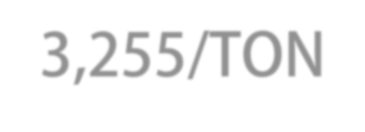
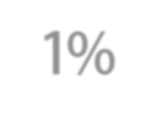
2024 AQUAFAQ
The current population of the United Arab Emirates is 10,005,88 in 22021, based on World meter elaboration of the latest United Nations data
100% YEARLY CONSUMPTION 262,255/TON
UNITED ARAB EMIRATES
72% YEARLY IMPORT 189,000/TON
27%YEARLY LOCAL CATCH
70,000/TON
1% YEARLY FARMED
3,255/TON
3

Slide 4
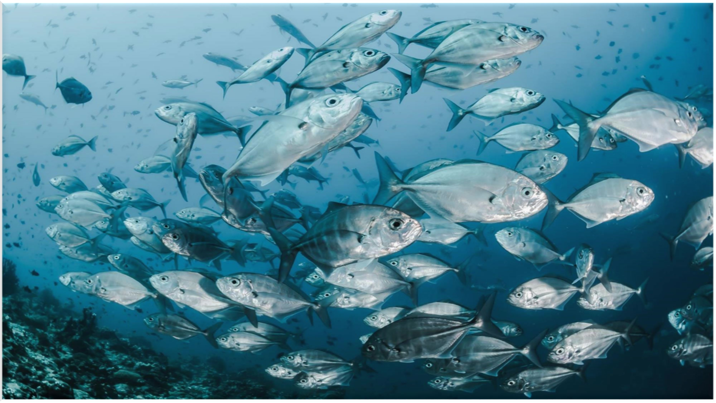
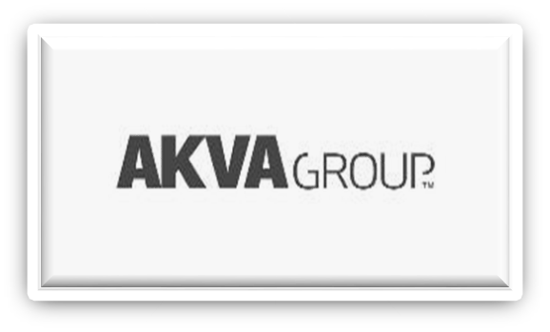
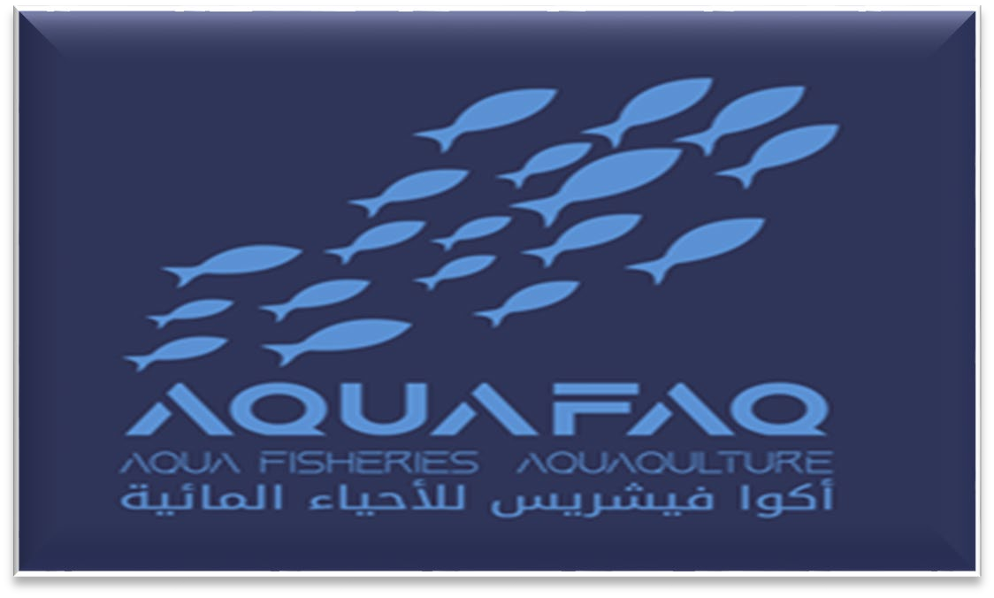
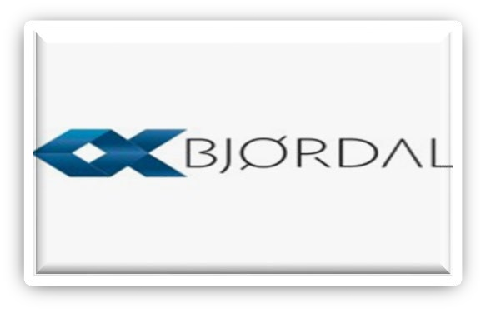
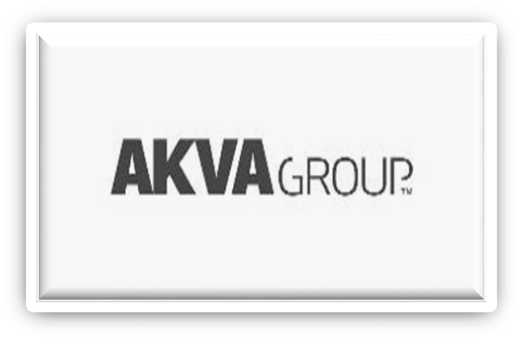
2024 AQUAFAQ
R&D EXPERTISE
Promote and Facilities Investment
4
E-LEARNING
Supporting Entities
Technology Provider
OFF-TAKE AGREEMENT
ENVIRONMENTS
FEED EQUIPMENT'S
ASMAK -UAE
MAINSTREAM - AUSTRALIA
PROCESSING PLANT
HATCHERY PLANT

Slide 5
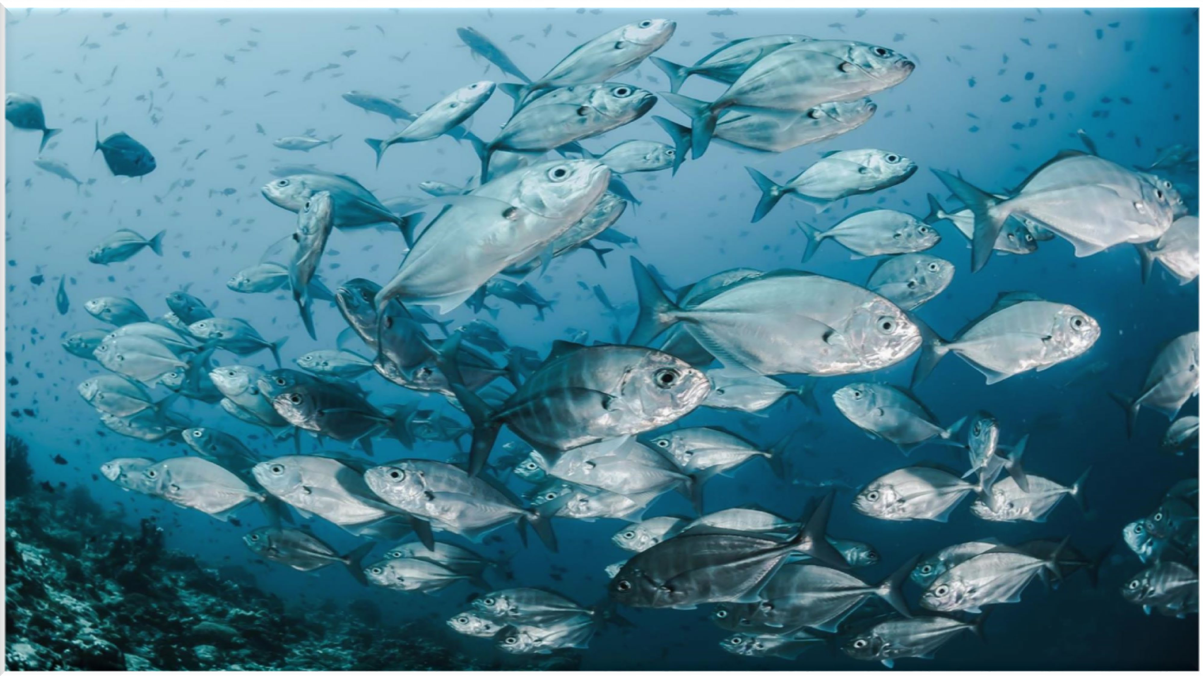
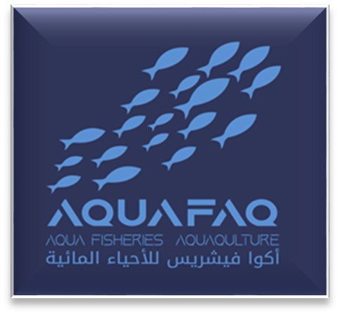
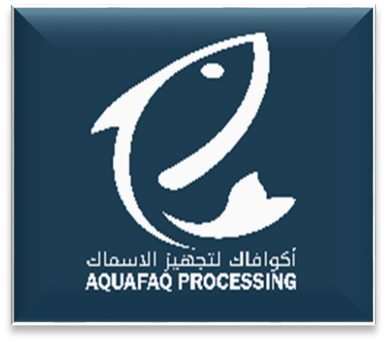
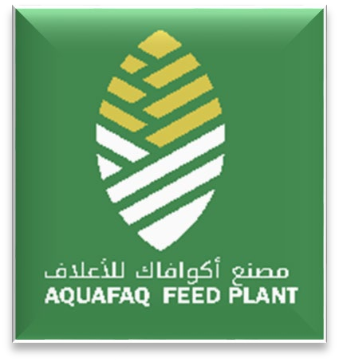
AQUAFAQ TOTAL PRODUCTIONS & MANPOWER
2024 AQUAFAQ
R & D MARKETING FINANCE HR SUPPORT
SEA CAGES 20,000/TON
FISH FEED 60,000/TON
HATCHERY 40,000,000/
PROCESSIN 20,00G0/TON
OTHER SUPPORT TEAM
MANPOWER -292
MANPOWER -133
MANPOWER -20
MANPOWER -25
MANPOWER -105
TOTAL PROJECTSP216 & P1000
TOTAL AQUAFAQ MANPOWER -575
5

Slide 6
WIND AND SOLAR PROJECTS
2024 AQUAFAQ
AQUAFAQ WORKS WITH ENERGY COMPANIES ACROSS THE GLOBE TO BRING ON NEW RENEWABLE PROJECTS DEDICATED TO SERVING OUR LOAD. MANY OF THESE PROJECTS ARE ENABLED BY LONG-TERM CONTRACTS SUCH AS POWER PURCHASE AGREEMENTS WITH LARGE WIND AND SOLAR PROJECTS IN THE SAME ENERGY GRIDS AS OUR ELECTRICITY USE.
6

Slide 7
AQUAFAQ MARKETING STRATEGY
2024 AQUAFAQ
AQUAFAQ OFF-TAKE AGREEMENT
Off-take MOU with Alliance Foods Company LLC Dubai DIC “ASMAK ” in UAE.
Off-take Agreement with Australian Main Stream Company.
TARGET MARKET
Local target market includes local and foreign people, restaurants and hotels. The Project’s target wholesale market includes:
Fish markets
Large Hypermarket In UAE
Restaurants
Hotels
Oil Companies through Al-Dhafra Co-operative Society
Fresh SEA BREAM Price: $10.89 to $12.25 Fresh Barramundi $10.08 / 1 Kg.
Fresh RED SNAPPER $13.07 / 500gm $11.71 / 500gm. Fresh GROUPER Price: $14.16 / 500gm $13.48 / 500gm

Slide 8
AQUAFAQ TOP MANAGEMENT ORGANIZATION CHART
2024 AQUAFAQ
EXTERNAL AUDITOR INTERNAL AUDITOR
 | ABDELKAFI HOUSSEM CHIEF OPERATING OFFICER COO
SİNAN TOPLU
SEA CAGE DIRECTOR
ANJU MENON HUMAN RESOURCES (HR)
AHMED KHALIFA MIRGHANI CHIEF MARKETING OFFICER CMO
ESSAM AHMED SALAMA CHIEF SUPPORT OFFICER CSO
SUPPORT TEAM
AHMED BAATOUT FEED PLANT DIRECTOR
FOUNDER , CHAIRMAN & CEO ABDUL HAKIM M. AL-SUWAIDI
AMIN GOLPOUR DEHSARI
Processing Director
AJAYA KUMAR. V K.
Hatchery Director
DEPUTY CHIEF EXECUTIVE OFFICER
ESSA AL-SUWAIDI
Mohamed Jawhar Chief Financial and officer
CFO
EFSTATHIOS LAMPAKIS
R & D Director
8

Slide 9
PLOT NO P 216 SIZE :156,931m2
2024 AQUAFAQ
PLOT NO P 1000 SIZE :250,096m2

Slide 10
AQUAFAQ PROJECTS PLOTS LEASED PLOTS CAN BE MORTGAGED
INVESTMENT PROJECT | PLOT NUMBER | AREA IN SQMT | PERMITTED USE | LAND VALUED PRICE ACCORDING TO MUNICIPALIT Y INDEX 2ND QUARTER 2020 | LAND VALUED PRICE ACCORDING TO MUNICIPALITY INDEX 2ND QUARTER 2020 | 30 YEARS RENTAL
 |  |  |  | USD $ | USD $ | USD $
AQUAFAQ FISHERIES COMPLEX | P216 | 156,118 | PROCESSING AND FEEDING UNITS , HATCHERY PLANT , MARINE INVERMINTAL CENTER , LABORATORIES STORGE FACILITIES, ADMINSTRATION OFFICES AND TRAINING CENTER , STAFF ACCOMMODATION | $681 | $106,316,358 | $128,338
SEA CAGE SYSTEM | P1000 | 250,096 | SEA CAGE SYSTEM | $681 | $170,315,376 | $204,605
TOTAL |  |  |  |  | $276,631,734 | $332,943
2024 AQUAFAQ

Slide 11
JAFZA
Salmon 250 tons
Yellowtail King 250 tons
Umm Al Quwain
Hatchery Seabream 4 Frys
Dibba Farm
Seabream 600 tons
60 Cages
Aquaculture Base Map
Plam Jabel Ali
Hamour 100 tons Sea Cages
Al Jurf Farm
Tilapia 100 tons
Acquired by IHC
Dibba bay
Oysters
For Pharmaceutical
Dubai South Farm
Safi
30 tons
Kalba
Land base Hamour 250 tons
Under construction
AquaFaq
Barramundi Hamour
Red Snapper 10,000 tons
Operation by September
Asmak Processing
40,000 tons Part of IHC
Al Jurf Farm
Shrimps Hamour 100 tons
Acquired by IHC
Abu Al Abyad
Hatchery & Farms Local fisheries Research
Aquaponic Farms
3 Farms
100 tons Acquired by IHC
Emirates Aquatech
No commercial operation Acquired by IHC
Al Wathba
Hamour 100 tons
Acquired by IHC
Aquaculture fisheries
2024 AQUAFAQ
i n v e s t i n a b u d h a b i . g o v . a e

Slide 12
Aquaculture Base Map
Bushehr
Shrimps 60,000 tons
100,000 planned
Kabgan
Barramundi 1,000 tons
Qeshm
Shrimps Hatchery Barramundi
3,000 tons
2024 AQUAFAQ
Fish Farm
Seabream R&D
Tabouk
New Farm
Under construction
Niska
Seabream Barramundi Red Snapper 3,000 tons
Hatchery
R&D
Al Dalim
Tilapia 5,000 tons
Under construction
Samakna Farm
Stopped
Mastoura
New Farm
Under construction
Al Bustan Farm
Hatchery
Marine Science & Fisheries Center
Al Laith
70 km Long 2bn Investment Barramundi 6,000 tons
Samakna Farm
Shrimps 2,000 tons
Under construction
Samakna Farm
Parramundi 1,000 tons
Planned 10 tons
Quriyat Farm
Seabream 1,000 tons
Fry From Greece
Al Laith
70 km Long 2bn Investment Shrimps 60,000 tons
Al Haridhah
Processing & Retail Under construction
Al Duqum
Integrated Aquaculture Under construction
Aquaculture fisheries
Salala Farm
Shrimps 1,000 tons

Slide 13
Total current production for Aquaculture Fisheries in tons/year
2024 AQUAFAQ

Slide 14
2024 AQUAFAQ
14

Slide 15
AQUAFAQ PROJECTS
2024 AQUAFAQ
ROADMAP TAGLINE PLOT P1000
2024
2,000/t
2025
6,000/t
2026
10,000/t
2027
14,000/t
2028
20,000/t
Species | 2025-2026 Phase 2 Qty Tons
Barramundi | 2,000
Red Snapper | 2,000
Sea Bream | 2,000
Grouper | -
TOTAL | 6,000
Species | 2026-2027 Tons
Barramundi | 3,000
Red Snapper | 3,000
Sea Bream | 2,000
Grouper | 2,000
TOTAL | 10,000
Species | 2028-2029 Phase 5 Qty Tons
Barramundi | 6,000
Red Snapper | 6,000
Sea Bream | 4,000
Grouper | 4,000
TOTAL | 20,000
Species | 2024-2025 Phase 1 Qty Tons
Barramundi | 1000
Red Snapper | 500
Sea Bream | 500
Grouper | -
TOTAL | 2,000
Phase 3 Qty in
Species | 2027-2028 Tons
Barramundi | 4,000
Red Snapper | 4,000
Sea Bream | 3,000
Grouper | 3,000
TOTAL | 14,000
Phase 4 Qty
15

Slide 16
AQUAFAQ PROJECTS
2024 AQUAFAQ
ROADMAP TAGLINE PLOT P216 2024-2025
Appointing consultants , and conducting of shore testing preparing Projects Business Plan , submitting master plan , and arranging Projects Funding ,Mobilization , completing all in land projects, Accommodation , Offices and R&D Building , Feeding Plant , Processing Plant , Hatchery.
Q1
Q2
Q3
Q4
Q1
Q2
Q3
Q4
2024
2025

Slide 17
2024 AQUAFAQ
BECAUSE STORYTELLING, AND VISUAL STORYTELLING,
WAS PUT IN THE HANDS OF EVERYBODY, WE HAVE ALL NOW BECOME STORYTELLERS

